Slide 1
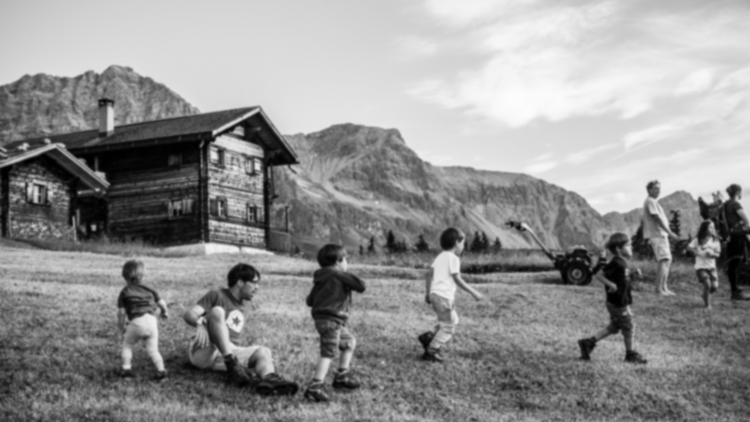

MATILDE MOOC Lecture 1 Introduction to the Course

Slide 2
Dealing with Rural Development in Europe
A shared vision for the future of rural Europe:
Rural, mountain and remote regions should be considered as the new heart of Europe (also see Matilde Manifesto, https://matilde-migration.eu/press-releases/matilde-manifesto-calls-to-redefine-eus-mountainous-and-rural-areas/)
Necessary to apply new approaches, and also achieve transformations in rural development action
Essential to extend our view to include non-agricultural policies affecting rural areas, recognizing that a host of additional activities are relevant for rural areas and have substantial influence on the performance of these regions (Dax and Copus, 2018)
“Local dimension" and "bottom-up" participation are crucial and has a pivotal role in each regional development process.

Slide 3
The quest for under which conditions the arrival of newcomers can turn into a local development opportunity for remote territories
Migration has a potential to trigger development in the medium and long run especially in remote areas with a depopulation trend.
This assumption presupposes that:
Remote areas should not be simply regarded as relief valves for asylum seekers unwelcome in urban areas
Attention is paid specifically to the management of reception and to the design of proper integration pathways, tailored to remote areas. (Galera et. al, 2018)

Slide 4
Immigration and fragile (remote) areas
The impact of mis- or poor management is notably more severe both for the asylum seekers and the hosting communities. Due to the fact that;
asylum seekers normally lack support structures
hosting communities tend to be more homogeneous and hence less migration-friendly.
However, a well-designed reception and integration project can have more visible beneficial impacts in remote areas when compared to urban contexts;
It is more likely to create win-win situations, including (1) the revitalisation of abandoned spaces and (2) the generation of a new demand for general-interest services otherwise at risk of survival

Slide 5
Indicators of and Strategies for
Successful Integration
An indicator of successful integration is the share of recipients overall hosted that decide to settle down in the receiving territory once granted the status of refugee or some other form of international protection.
This happens normally when recipients succeed in finding both a regular job and a suitable accommodation.
An additional indicator of successful integration is the number of family reunifications accomplished.

Slide 6
Strategies for supporting the newcomers
Strategies for supporting the integration of asylum seekers, refugees and status holders in the long-run need a territorial approach that includes the following specificities in remote areas with declining population (Galera et. al, 2018: 32):
Preparation and engagement of local inhabitants at an early stage and in a sustainable way
Adoption of a full-scale system of decentralised housing for asylum seekers, accommodated in small groups rather than in big centres
Proper utilisation of practice-oriented skills of migrants (design of innovative tools)
Activation of socio-economic integration pathways in local communities right after the arrival of asylum seekers on the territory
Design of educational policies (supporting the social inclusion of foreign-born children); housing policies (preventing ghettoisation of refugees and status holders who decide to settle down); and territorial welfare services (accessible to all recipients).
Development of fruitful relations by different levels of governance and by local actors and third sector organisations

Slide 7
Arrival of newcomers as a local development opportunity
Under which conditions can the arrival of newcomers turn into a local development
opportunity for sparsely populated and at risk of being abandoned territories?
new employment
new demand for services and goods (resulting from the increase in number of people residing in a given territory)
This also may entail the survival or re-opening of schools, medical clinics and local shops otherwise doomed to close down.
There is, in general, slow policy shift from a system of assistance towards one of work integration. The case studies so far highlight the importance of designing individualised integration paths backed by social inclusion initiatives.

Slide 8
Readings
Required Readings:
Galera, G., Giannetto, L., Membretti, A, and Noya, A. (2018). “Integration of Migrants, Refugees and Asylums Seekers in Remote Areas with Declining Populations”, OECD Local Economic and Employment Development (LEED) Papers 2018/03, OECD Publishing: Paris, https://www.oecd-ilibrary.org/industry-and-services/integration-of-migrants-refugees-and-asylum-seekers-in-remote-areas-with-declining-populations_84043b2a-en
Dax, T. and Copus A. (2018). “Towards Vibrant, Inclusive and Sustainable Rural Regions: Orientations for a Future Rural Cohesion Policy.” European Structural and Investment Funds Journal (ESTIF) 6(3): 198 -209.
Suggested Readings:
Boccagni, P. (2017). Migration and the Search for Home. Mapping Domestic Space in Migrants’ Everyday Lives. Palgrave: London.
Bock, B. (2016). “Rural Marginalisation and the Role of Social Innovation; A Turn Towards Nexogenous Development and Rural Reconnection”, Sociologia Ruralis 56(4) 552-573.

Slide 9

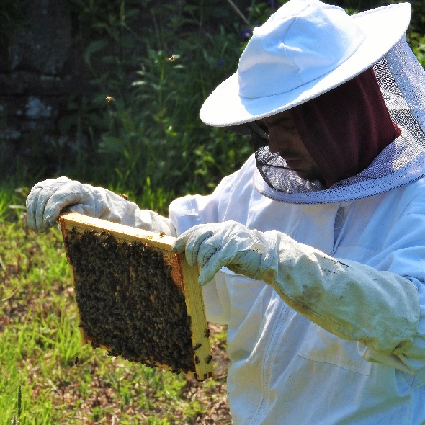
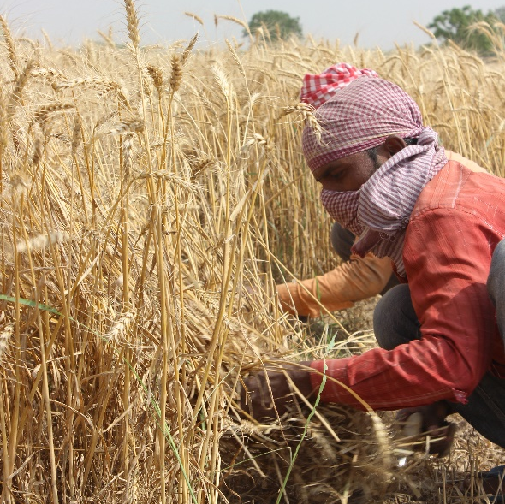
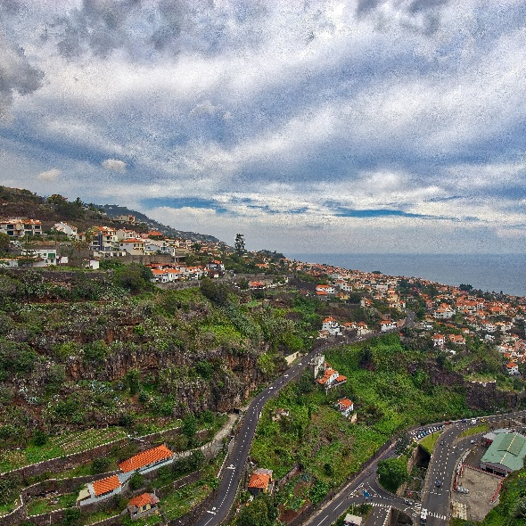




/matildemigration
/MATILDE_Mig
/MatildeProject
/MATILDE Migration
Slide 9

